Slide 1

Tutorial 3: Graphs
Zhang Ao
aozhang@u.nus.edu

Slide 2
Problem 1
In Spark Structured Streaming, why we need to specify a checkpoint location?

Slide 3
Solution 1
In Spark Structured Streaming, why we need to specify a checkpoint location?
Answer: to save the progress information of a stream query, i.e. what data has been successfully processed. Upon failure, this info is used to restart the failed query exactly where it left off.

Slide 4
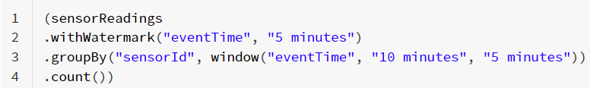
Problem 2
In Spark Structured Streaming, we are using below codes to collect the streaming data from sensor readings.
From 12:05 to 12:10, we have received below events:
And at 12:10 the below result table is triggered:
Event Table
sensorID | Event Time
id1 | 12:06
id1 | 12:08
Result Table
Event Window | sensorID | Count
11:50-12:00 | id1 | 1
11:55-12:05 | id1 | 1
12:00-12:10 | id1 | 2
12:05-12:15 | id1 | 2

Slide 5
Problem 2
From 12:10 to 12:15, we received three more events per below:
Please provide the result table at 12:15.
Event Table
sensorID | Event Time
id1 | 11:54
id1 | 12:02
id1 | 12:13
Result Table
Event Window | sensorID | Count
11:50-12:00 | id1
11:55-12:05 | id1
12:00-12:10 | id1
12:05-12:15 | id1
12:10-12:20 | id1

Slide 6
Problem 2
What does the code mean?
watermark: do not process too long ago data.
The watermark will take the most recent data’s time (e.g. 12:08).
The windows before 12:08-5min=12:03 will not be updated.

Slide 7
Problem 2
What does the code mean?
Result Table
Event Window | sensorID | Count
11:50-12:00 | id1 | 1
11:55-12:05 | id1 | 1
12:00-12:10 | id1 | 2
12:05-12:15 | id1 | 2

Slide 8
Solution 2
What we need to do?
Event Table
sensorID | Event Time
id1 | 11:54
id1 | 12:02
id1 | 12:13
Event Table
sensorID | Event Time
id1 | 12:06
id1 | 12:08
new coming data
Result Table
Event Window | sensorID | Count
11:50-12:00 | id1
11:55-12:05 | id1
12:00-12:10 | id1
12:05-12:15 | id1
12:10-12:20 | id1
Result Table
Event Window | sensorID | Count
11:50-12:00 | id1 | 1
11:55-12:05 | id1 | 1
12:00-12:10 | id1 | 2
12:05-12:15 | id1 | 2

Slide 9
Solution 2
What we need to do?
Event Table
sensorID | Event Time
id1 | 11:54
id1 | 12:02
id1 | 12:13
Event Table
sensorID | Event Time
id1 | 12:06
id1 | 12:08
new coming data
Result Table
Event Window | sensorID | Count
11:50-12:00 | id1 | 1
11:55-12:05 | id1 | 1
12:00-12:10 | id1 | 2
12:05-12:15 | id1 | 2
12:10-12:20 | id1 | 0
Result Table
Event Window | sensorID | Count
11:50-12:00 | id1 | 1
11:55-12:05 | id1 | 1
12:00-12:10 | id1 | 2
12:05-12:15 | id1 | 2
copy first

Slide 10
Solution 2
What we need to do?
Event Table
sensorID | Event Time
id1 | 11:54
id1 | 12:02
id1 | 12:13
Event Table
sensorID | Event Time
id1 | 12:06
id1 | 12:08
new coming data
-5min=12:03
Result Table
Event Window | sensorID | Count
11:50-12:00 | id1 | 1
11:55-12:05 | id1 | 1
12:00-12:10 | id1 | 2
12:05-12:15 | id1 | 2
12:10-12:20 | id1 | 0
Result Table
Event Window | sensorID | Count
11:50-12:00 | id1 | 1
11:55-12:05 | id1 | 1
12:00-12:10 | id1 | 2
12:05-12:15 | id1 | 2
find windows to update with watermark

Slide 11
Solution 2
What we need to do?
Event Table
sensorID | Event Time
id1 | 11:54
id1 | 12:02
id1 | 12:13
Event Table
sensorID | Event Time
id1 | 12:06
id1 | 12:08
new coming data
-5min=12:03
Result Table
Event Window | sensorID | Count
11:50-12:00 | id1 | 1
11:55-12:05 | id1 | 1+1 = 2
12:00-12:10 | id1 | 2+1 = 3
12:05-12:15 | id1 | 2+1 = 3
12:10-12:20 | id1 | 0+1 = 1
Result Table
Event Window | sensorID | Count
11:50-12:00 | id1 | 1
11:55-12:05 | id1 | 1
12:00-12:10 | id1 | 2
12:05-12:15 | id1 | 2
update

Slide 12
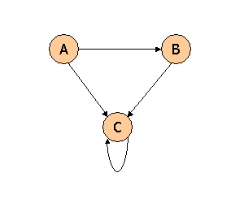
Problem 3
Consider three Web pages with the following links:
Suppose we compute PageRank with a β of 0.7 (note: we assume that the sum of the PageRanks of the three pages must be 1, to handle the problem that otherwise any multiple of a solution will also be a solution). Compute the PageRanks a, b, and c of the three pages A, B, and C, respectively.

Slide 13
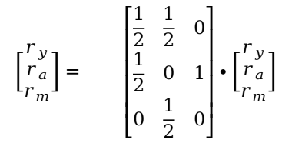
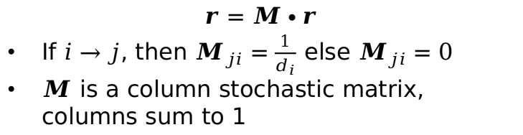
PageRank (without teleport)
y
a
m
Starting point
End point
$$\left[\begin{aligned}r_{y} \\ r_{a} \\ r_{m}\end{aligned}\right]= \left[\begin{matrix}\frac{1}{2} & \frac{1}{2} & 0 \\ \frac{1}{2} & 0 & 1 \\ 0 & \frac{1}{2} & 0\end{matrix}\right]∙\left[\begin{aligned}r_{y} \\ r_{a} \\ r_{m}\end{aligned}\right]$$
y
y
The denominator is the out-degree of starting points.
a
a
m
m
$$r=M∙r$$
If $i→j$, then $M_{ji}=\frac{1}{d_{i}}$ else $M_{ji}=0$
$M$ is a column stochastic matrix, columns sum to 1

Slide 14
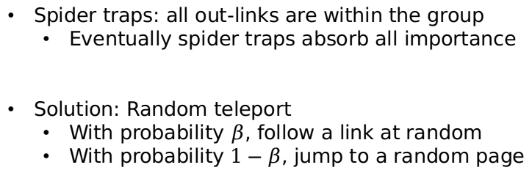
y
a
m
Spider traps: all out-links are within the group
Eventually spider traps absorb all importance
Solution: Random teleport
With probability $β$, follow a link at random
With probability $1−β$, jump to a random page

Slide 15




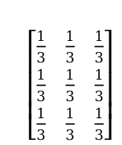
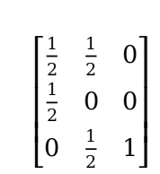

PageRank (with teleport)
y
$$A=βM+\left(1−β\right){\left[\frac{1}{N}\right]}_{N×N}$$
a
m
y
a
m
y
a
m
$\left[\begin{matrix}\frac{1}{2} & \frac{1}{2} & 0 \\ \frac{1}{2} & 0 & 0 \\ 0 & \frac{1}{2} & 1\end{matrix}\right]$
$\left[\begin{matrix}\frac{1}{3} & \frac{1}{3} & \frac{1}{3} \\ \frac{1}{3} & \frac{1}{3} & \frac{1}{3} \\ \frac{1}{3} & \frac{1}{3} & \frac{1}{3}\end{matrix}\right]$
y
y
$$β×$$
a
$$+(1−β)×$$
a
=$A$
m
m
$$r=A∙r$$
Additional constraint: r₁ + r₂ + … + r_{n} = 1
Notes:
Random jump even though there is no link

Slide 16
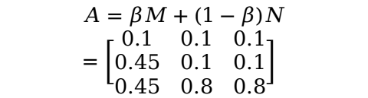
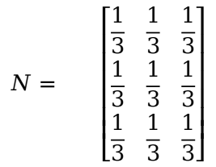
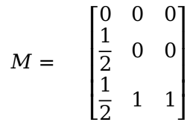
Solution 3
A
B
C
A
B
C
$$N= \left[\begin{matrix}\frac{1}{3} & \frac{1}{3} & \frac{1}{3} \\ \frac{1}{3} & \frac{1}{3} & \frac{1}{3} \\ \frac{1}{3} & \frac{1}{3} & \frac{1}{3}\end{matrix}\right]$$
A
A
$$M= \left[\begin{matrix}0 & 0 & 0 \\ \frac{1}{2} & 0 & 0 \\ \frac{1}{2} & 1 & 1\end{matrix}\right]$$
B
B
C
C
$$A=βM+\left(1−β\right)N=\left[\begin{matrix}0.1 & 0.1 & 0.1 \\ 0.45 & 0.1 & 0.1 \\ 0.45 & 0.8 & 0.8\end{matrix}\right]$$

Slide 17
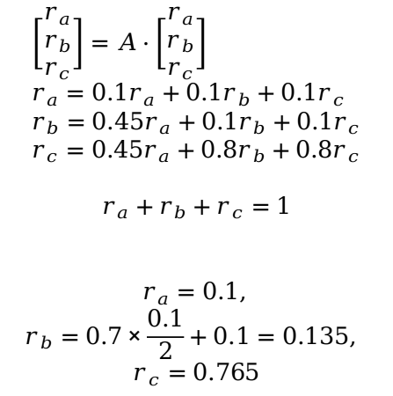
Solution 3
$$\left[\begin{matrix}r_{a} \\ r_{b} \\ r_{c}\end{matrix}\right]=A⋅\left[\begin{matrix}r_{a} \\ r_{b} \\ r_{c}\end{matrix}\right] \\ r_{a}=0.1r_{a}+0.1r_{b}+0.1r_{c} \\ r_{b}=0.45r_{a}+0.1r_{b}+0.1r_{c} \\ r_{c}=0.45r_{a}+0.8r_{b}+0.8r_{c}$$
$$r_{a}+r_{b}+r_{c}=1$$
$r_{a}=0.1,$ $$r_{b}=0.7×\frac{0.1}{2}+0.1=0.135,$$
$$r_{c}=0.765$$

Slide 18
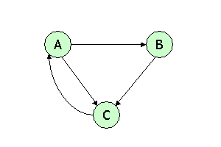
Problem 4
Consider three Web pages with the following links:
Suppose we compute PageRank with β=0.85. Write the equations for the PageRanks a, b, and c of the three pages A, B, and C, respectively.

Slide 19
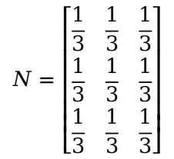
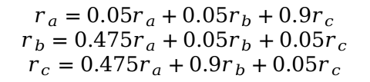

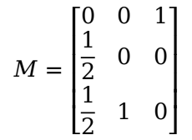
Solution 4
$$N=\left[\begin{matrix}\frac{1}{3} & \frac{1}{3} & \frac{1}{3} \\ \frac{1}{3} & \frac{1}{3} & \frac{1}{3} \\ \frac{1}{3} & \frac{1}{3} & \frac{1}{3}\end{matrix}\right]$$
$$M=\left[\begin{matrix}0 & 0 & 1 \\ \frac{1}{2} & 0 & 0 \\ \frac{1}{2} & 1 & 0\end{matrix}\right]$$
$$A=βM+\left(1−β\right)N=\left[\begin{matrix}0.05 & 0.05 & 0.9 \\ 0.475 & 0.05 & 0.05 \\ 0.475 & 0.9 & 0.05\end{matrix}\right]$$
$$r_{a}=0.05r_{a}+0.05r_{b}+0.9r_{c}$$
$$r_{b}=0.475r_{a}+0.05r_{b}+0.05r_{c}$$
$$r_{c}=0.475r_{a}+0.9r_{b}+0.05r_{c}$$

Slide 20
Thanks! Q & A
Zhang Ao
aozhang@u.nus.edu

